Slide 1
CSCI2100E Graph

Slide 2
Graphs
A graph is G = (V, E) where V is a set of nodes (vertices), and E is a set of edges. (An edge is a pair of nodes.)
We use V(G) and E(G) to denote the set of nodes and the set of edges of G, respectively.
Let n be the number of nodes in V(G), e.g., |V(G)|.
Let m be the number of edges in E(G), e.g., |E(G)|
Many books, use m to denote the number of edges. In this textbook, it uses e.
Tree is a graph.
0
0
1
2
1
2
3
4
G₁
3
Tree

Slide 3
Undirected Graphs
A graph is an undirected graph, if there is no order in an edge. The two edges, (v₀, v₁) and (v₁, v₀), in a undirected graph represent the same edge.
An example:
V(G₁) = {0, 1, 2, 3},
E(G₁) = {(0,1), (0,2), (0,3), (1,2), (1,3), (2,3)}.
0
1
2
G₁
3

Slide 4
Directed Graphs
A graph is a directed graph if there is an order in an edge. The two edges, <v₀, v₁> and <v₁, v₀> in a directed graph represent two different edges.
An example:
V(G₂) = {0, 1, 2},
E(G₂) = {<0, 1>, <1, 0>, <1, 2>}.
0
1
G₂
2

Slide 5
Graphs
There are many graphs. Here, we only consider the graphs with the following two restrictions.
No self-loops, (v_{i}, v_{i}), in an undirected graph or <v_{i}, v_{i}> in a directed graph.
No multiple occurrences of the same edge.
0
1
3
2

Slide 6

Graphs
Complete graph is a graph that has the maximum number of edges.
If an undirected graph has $n$ nodes, the maximum number of distinct unordered pairs is $n(n−1)/2$.
If a directed graph has $n$ nodes, the maximum number of distinct ordered pairs is $n(n−1)$.
0
1
2
A complete directed graph with 3 nodes

Slide 7
Complete Undirected Graphs
With all possible edges
n = 1
n = 2
n = 3
n = 4

Slide 8

Graphs
Subgraph: A graph G' is a subgraph of G if V(G') $⊆$ V(G) and E(G') $⊆$ E(G).
0
0
0
1
2
1
2
2
G
3
3
3
(a) An undirected graph G
(b) A subgraph of G
(c) Another subgraph of G

Slide 9
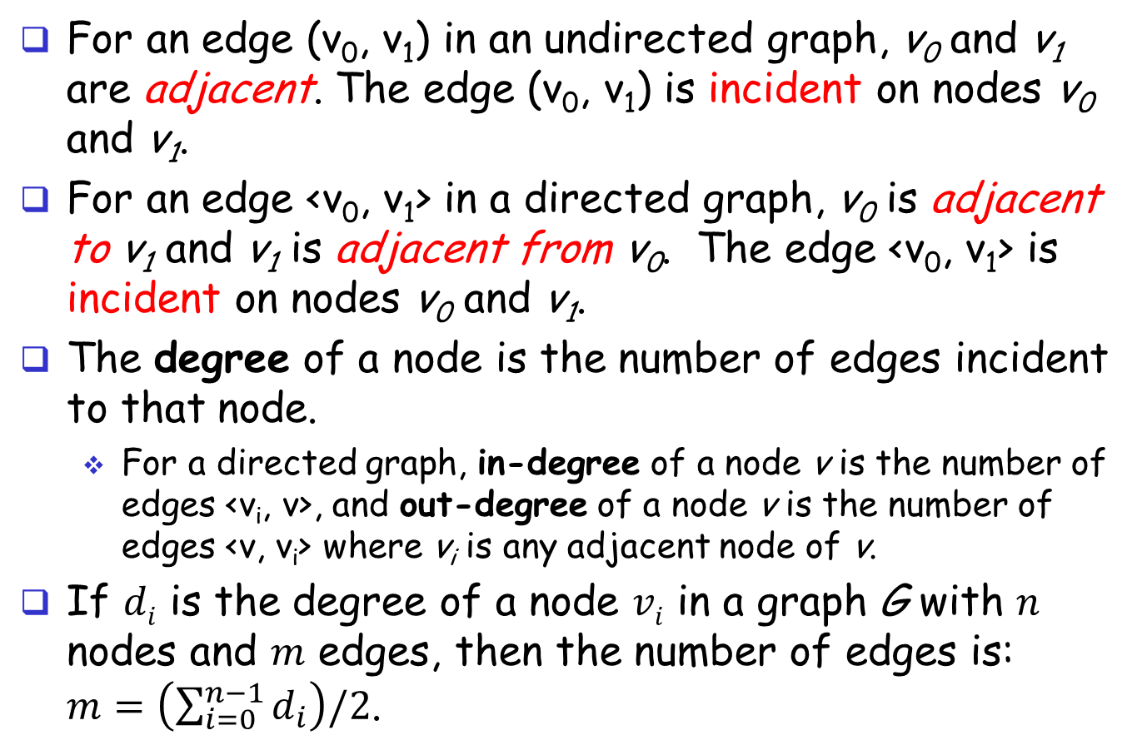
Graphs
For an edge (v₀, v₁) in an undirected graph, v₀ and v₁ are adjacent. The edge (v₀, v₁) is incident on nodes v₀ and v₁.
For an edge <v₀, v₁> in a directed graph, v₀ is adjacent to v₁ and v₁ is adjacent from v₀. The edge <v₀, v₁> is incident on nodes v₀ and v₁.
The degree of a node is the number of edges incident to that node.
For a directed graph, in-degree of a node v is the number of edges <v_{i}, v>, and out-degree of a node v is the number of edges <v, v_{i}> where v_{i} is any adjacent node of v.
If $di$ is the degree of a node $vi$ in a graph G with $n$ nodes and $m$ edges, then the number of edges is: $m=\left(\sum_{i=0}^{n−1}{d_{i}}\right)/2$.

Slide 10
Graphs: Examples
0
0
0
2
1
2
1
2
1
3
3
(2+2+2)/2 = 3
(2+1+2+1)/2 = 3

Slide 11
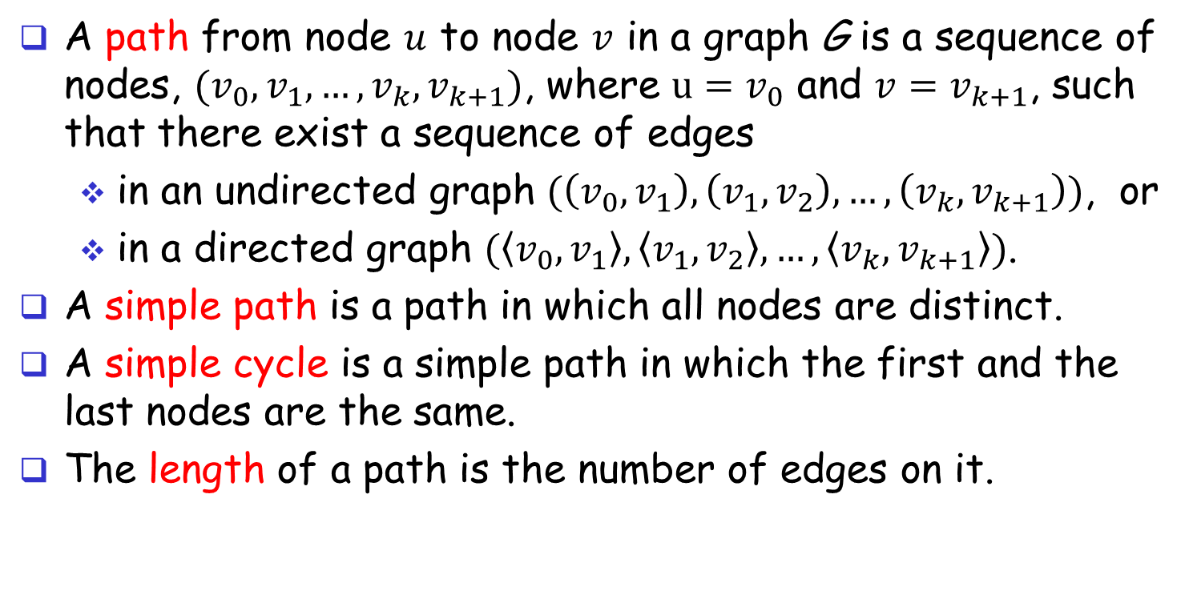
Paths
A path from node $u$ to node $v$ in a graph G is a sequence of nodes, $(v_{0},v_{1},…,v_{k},v_{k+1})$, where $u=v_{0}$ and $v=v_{k+1}$, such that there exist a sequence of edges
in an undirected graph $(\left(v_{0},v_{1}\right),\left(v_{1},v_{2}\right),…,\left(v_{k},v_{k+1}\right))$, or
in a directed graph $(\left\langle v_{0},v_{1}\right\rangle ,\left\langle v_{1},v_{2}\right\rangle ,…,\left\langle v_{k},v_{k+1}\right\rangle )$.
A simple path is a path in which all nodes are distinct.
A simple cycle is a simple path in which the first and the last nodes are the same.
The length of a path is the number of edges on it.

Slide 12
Paths in Graphs: Examples
0
0
0
1
2
2
1
2
3
1
3
P = (1,0,2,3)
P = (3,2,0,1)
P = (0,1,2,0)
P = (0,1,3,2,1,0,2)
P = (1,0,3,2)
P = (1,0,3,2,1)

Slide 13
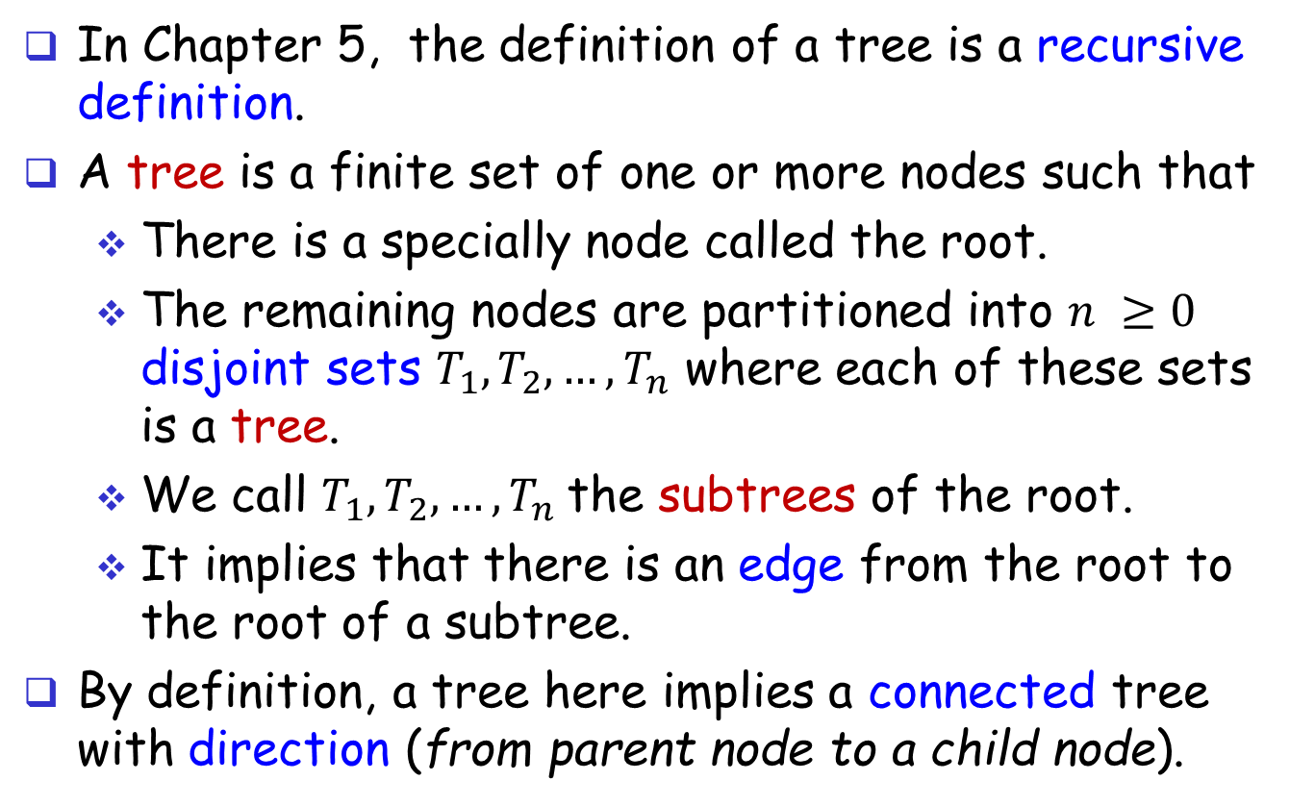
Review Trees (1)
In Chapter 5, the definition of a tree is a recursive definition.
A tree is a finite set of one or more nodes such that
There is a specially node called the root.
The remaining nodes are partitioned into $n ≥0$ disjoint sets $T_{1}, T_{2},…, T_{n}$ where each of these sets is a tree.
We call $T_{1}, T_{2}, …, T_{n}$the subtrees of the root.
It implies that there is an edge from the root to the root of a subtree.
By definition, a tree here implies a connected tree with direction (from parent node to a child node).

Slide 14
Review Trees (2)
Based on the edges, we can define a path, and the length of a path.
The degree of a node defined on a tree is the number of subtrees (the number of child nodes).
Ancestors of a node, v, are the nodes on the path from the root to the node v excluding v itself.
Descendants of a node, v, are the nodes, u, if there is a path from v to u.
The level can be defined because there is a root.
The level of the root is 1, and the level of its child nodes are at level 2, and so no so forth.
For a tree, there is only one root.
A list is a special tree.

Slide 15
Review Graphs
A graph is G = (V, E) where V is a set of nodes (vertices), and E is a set of edges. (An edge is a pair of nodes.)
A tree is a special graph.
A tree only has one root. A graph may have many.
A root is defined as a node without in-coming edges.
The degree of a node defined on a tree is the out-degree of a node defined on a graph.
A tree has no cycles, but a graph may have many.
A node (except for the root) in a tree has one parent. A node in a graph may have many in-coming edges. So, there is no clear notion of parent in a graph. We use children, ancestors, and descendants on a graph, if the context is clear.

Slide 16
Graph ADT
A nonempty set of nodes and a set of undirected edges, where each edge is a pair of nodes. (Refer to ADT 6.1, page 271.)
Functions:
Graph Create(): return an empty graph.
Graph InsertVertex(G, v): return a graph G with v inserted, and v has no incident edges.
Graph InsertEdge(G, v₁, v₂): return a graph G with a new edge between v₁ and v_{2.}
Graph DeleteVertex(G, v): return a graph G in which v and all edges incident to it are removed.
Graph DeleteEdge(G, v₁, v₂): return a graph G in which the edge (v₁, v₂) is removed. Leave the incident nodes in the graph.
Boolean IsEmpty(G): if G is empty return TRUE else return FALSE.
List Adjacent(G, v): return a list of all nodes that are adjacent to v.

Slide 17
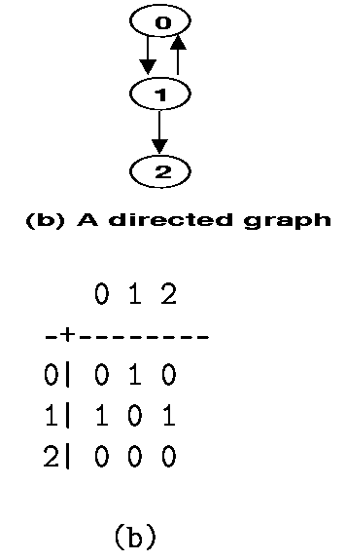
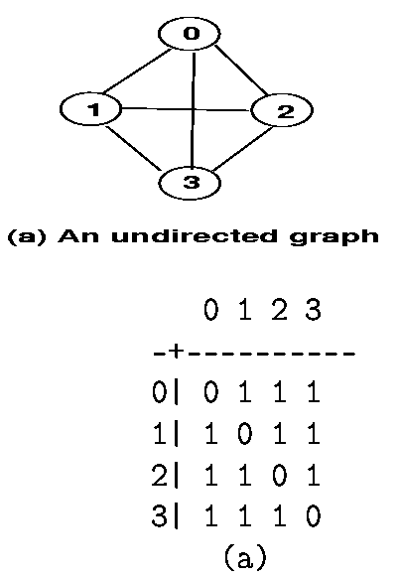
Graph Representation: Adjacency Matrix
Let A[i][j] be an adjacency matrix.

Slide 18
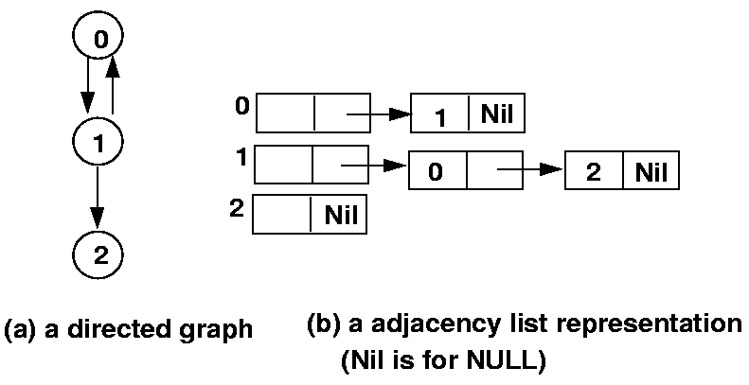
Graph Representation: Adjacency List
typedef struct _adjlist {
int node;
struct _adjlist *link;
} adjlist;
adjlist graph[MAX_NODES];

Slide 19
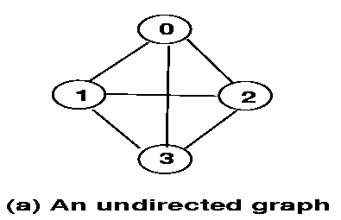
Adjacency List
For an undirected graph with n nodes and m edges, this representation requires n head nodes and 2m list nodes.
0
1
2
3
Nil
1
0
2
3
Nil
2
0
1
3
Nil
3
0
1
2
Nil

Slide 20
Adjacency List
Using the adjacency list for directed graphs, it is easy to find the out-degree of a node but harder to find the in-degree.
Use an additional inverse adjacency list.
0
1
Nil
1
0
Nil
2
1
Nil
(c) an inverse adjacency list

Slide 21

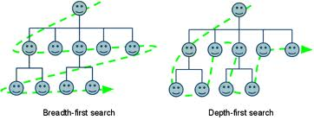
Depth-First or Breadth-First
Given a graph (e.g., a social network), how do you distribute information from a node?

Slide 22
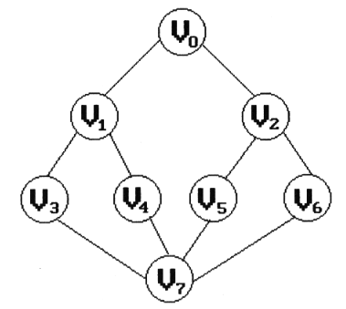
Depth-First Search (Depth-First Traversal)
Given a directed/undirected graph G = (V, E) and a start node, v, visit all nodes in the graph that are reachable from the start node.
What do we mean by “all”?
What is the result?
By the name of Depth-First, it will traverse G as far as possible from the start node along a path, all the time.
What do we mean by “far”?
Here, “far” is based on the length of the path traversing from v

Slide 23
Depth-First Search (DFS)
Given a graph G = (V, E) and a start node, v, visit all nodes in the graph that are reachable from the start node.
The result is not unique by definition, if we do not define an order among out-going edges from a node.
Possible results:
v0, v1, v3, v7, v4, v5, v2, v6.
v0, v1, v4, v7, v6, v2, v5, v3.
…
How many?

Slide 24
Depth-First Search
A pseudo code example dfs(node v){ remember the node v we are about to visit, and output the node v;
for (every node u that v and u are adjacent in G)
if (we have not visited u before)
dfs(u);
}

Slide 25
Depth-First Search
Give the data structures, and write it in C. typedef struct _adjlist { int node; struct _adjlist *link; } adjlist; adjlist graph[MAX_NODES]; /* adjacency list */ Boolean visited[MAX_NODES]; /* to remember visits */ void dfs(int v){
adjlist *w;
visited[v] = TRUE; printf("%d", v);
for (w = graph[v].link; w != NULL; w = w->link)
if (visited[w->node] == FALSE) dfs(w->node);
}

Slide 26
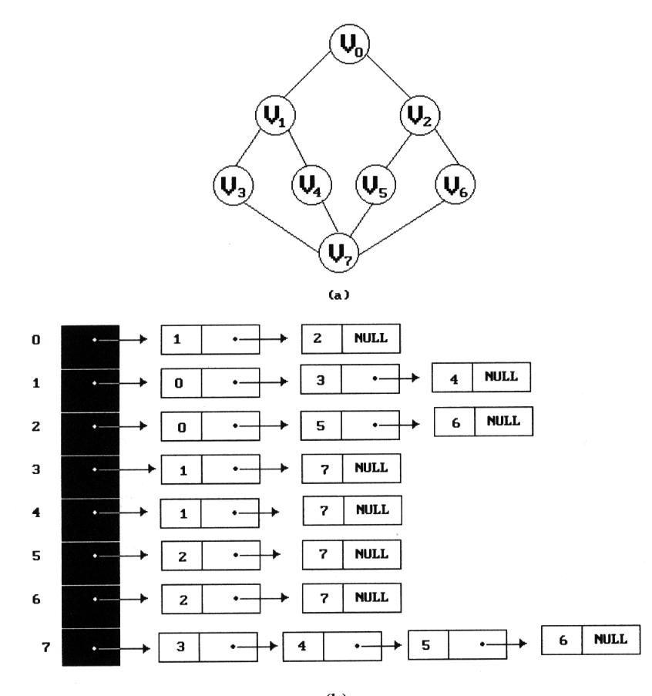
Depth First Search
Given the adjacency list and suppose the graph is stored as shown here. The answer is unique. Why? implementation dependent.
Start from v₀: dfs order: v₀, v₁, v₃, v₇, v₄, v₅, v₂, v₆

Slide 27
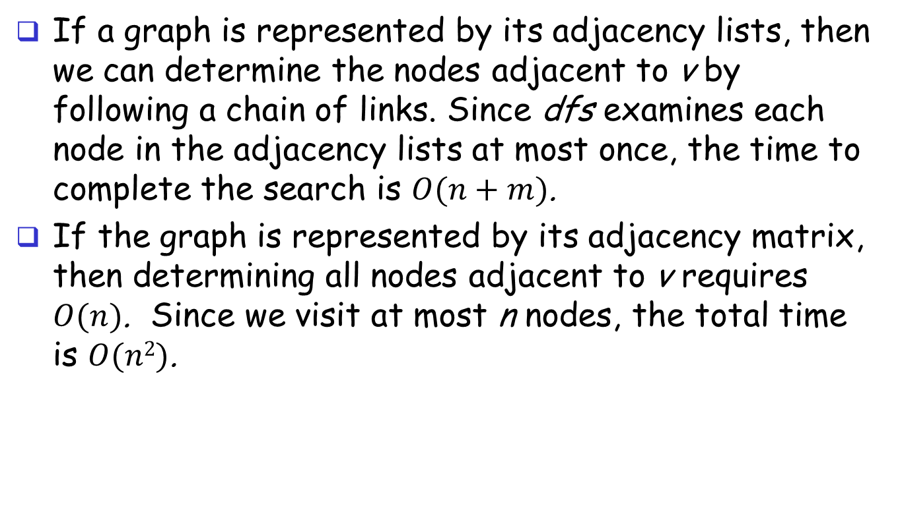
Depth First Search
If a graph is represented by its adjacency lists, then we can determine the nodes adjacent to v by following a chain of links. Since dfs examines each node in the adjacency lists at most once, the time to complete the search is $O(n+m)$.
If the graph is represented by its adjacency matrix, then determining all nodes adjacent to v requires $O(n)$. Since we visit at most n nodes, the total time is $O(n2)$.
n
m
n
n

Slide 28
Breadth-First Search (Breadth-First Traversal)
Given a graph G = (V, E) and a start node, v, visit all nodes that are reachable from v in an order to visit all nodes that are closer first before visiting the others.
By the name of Breadth-First, it will traverse G following the adjacency nodes.
The result is not unique by definition, if we do not define an order among out-going edges from a node.
Some possible results:
v0, v1, v2, v3, v4, v5, v6, v7.
v0, v2, v1, v6, v5, v4, v3, v7.

Slide 29
Breadth-First Search (Pseudo Code)
bfs(node v){
remember the node v we are about to visit, and output the node v; let q be a queue to remember the visiting order we have visited, and let it be empty initially.
enqueue the node v into q;
while (the queue is not empty){
let v be the node dequeued from q;
for (every node u that v and u are adjacent in G)
if (we have not visited u before){
output the node u;
enqueue u into q;
remember we have visited u; }
}
}}

Slide 30
Breadth-First Search (BFS)
void bfs(int v){
queue *q; adjlist *w;
printf("%d",v); visited[v] = TRUE;
q = createQ(MAX_NODES);
enqueue(q, v);
while (!IsEmptyQ(q)) {
v = dequeue(q);
for (w = graph[v].link; w != NULL; w = w->link)
if (visited[w->node] == FALSE) {
printf("%d", w->node);
enqueue(q, w->node);
visited[w->node] = TRUE;
}
}
}
}

Slide 31
Breadth-First Search
Given the adjacency list and suppose the graph is stored as shown here. The answer is unique. Why? implementation dependent.
Example: Start from v₀: bfs order: v₀, v₁, v₂, v₃, v₄, v₅, v₆, v₇

Slide 32

Breadth-First Search
Since each node is placed on the queue exactly once, the while loop is iterated at most $n$ times.
For adjacency list representation, this loop has a total cost of $O(n+m)$.
For the adjacency matrix representation, the while loop takes $O(n)$ time for each node visited. Therefore, the total time is $O(n2)$.

Slide 33
Connected Components
For an undirected graph G, a connected component of G is a subgraph where every two nodes are connected to each other by paths.
A graph G is connected, if every two nodes are connected.
We can check it using DFS or BFS starting from any node.
0
4
2
1
5
3
6
G₄
7

